Slide 1
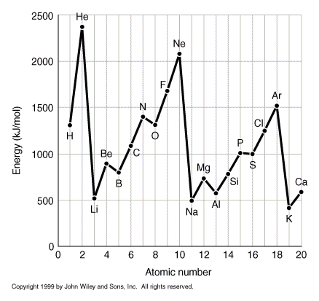
First Ionization Energies
Minimum energy to completely remove an e⁻ from the ground state atom in the gas phase.
H(g) -----> H⁺ + e⁻ E = 2.179 x 10⁻¹⁸ J (1312 kJ/mole)
  E = hν = hc / λ λ = hc / E = 91.18nm
Periodic Trends
Increases rapidly across periodic table.
Dramatic drop from end of one row to
beginning of next.
Gradual decrease down a column on
periodic table.
Some minor exceptions across
(e.g. Be -->B; N --> O).

Slide 2
Explanation For Trends
What if the electrons are at similar distances from the nucleus?
Compare H and He: the electron being removed from He “feels” a +2 nuclear charge, compared to a +1 charge in H. Therefore, should take more energy to remove the electron from He.
Observed!
e⁻
+1
H
e⁻
+2 e⁻
He

Slide 3
Explanation For Trends
What if the electrons are at similar distances from the nucleus?
e⁻
+1
H
e⁻
+2 e⁻
He
e⁻
+3 e⁻
Li
e⁻
For Li: would expect 1st ionization energy to be greater than for He. (NOT observed).
What if 3 electrons are not equidistant from nucleus?

Slide 4
Explanation For Trends
e⁻
+1
H
e⁻
+2 e⁻
He
e⁻
+3 e⁻
Li
e⁻
For Li: would expect 1st ionization energy to be greater than for He. (NOT observed).
What if 3 electrons are not equidistant from nucleus?
The nuclear charge “felt” by the outer electron would be shielded by inner two electrons and be ~equal to +1. In this case it would be easier to remove than 1st electron from either H or He. (Observed!)

Slide 5
Explanation For Trends
e⁻
e⁻
e⁻
e⁻
e⁻
e⁻
+11 e⁻
Na
e⁻
e⁻
+10 e⁻
Ne
e⁻
e⁻
e⁻
e⁻
e⁻
e⁻
e⁻
e⁻
e⁻
e⁻
e⁻
For Li through Ne there is an almost linear increase in 1st ionization energy because of the linear increase in effective nuclear charge felt by the outermost electrons (no additional shielding).
But, dramatic drop for Na. Next electron at farther distance from nucleus, so only “feels” +1 core effective nuclear charge.

Slide 6
Explanation For Trends
n = 1
n = 2
n = 3
Electrons found in groups called “Shells”, which we will designate 1, 2, 3, etc. (can hold 2e⁻, 8e⁻, 8e⁻, respectively).
Within the shells, the electrons are similar in distance from the nucleus.
Increasing nuclear charge across Periodic Table results in more energy being required to remove electron.
Subsequent shells are relatively further from nucleus and are “shielded”.

Slide 7
PES

Slide 8
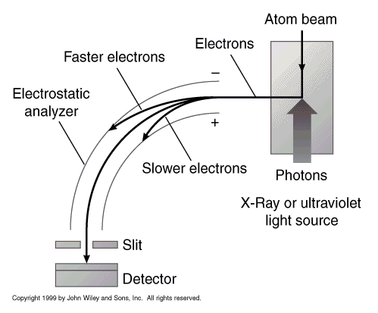
Photoelectron Spectroscopy (PES)
First ionization energy removes electron from outermost shell.
PES measures the energy to remove one electron from any shell of a neutral atom.
Energy of entering photon (hν) is larger than ionization energy (Ie), so the electron leaves the atom with excess kinetic energy (KE), which PES measures.
hν = Ie + KE
known (scanned) measured
determined
The difference between the energy of the photon and the kinetic energy of the ejected photon yields the ionization energy.
KE
Ie
n = ∞
hν

Slide 9
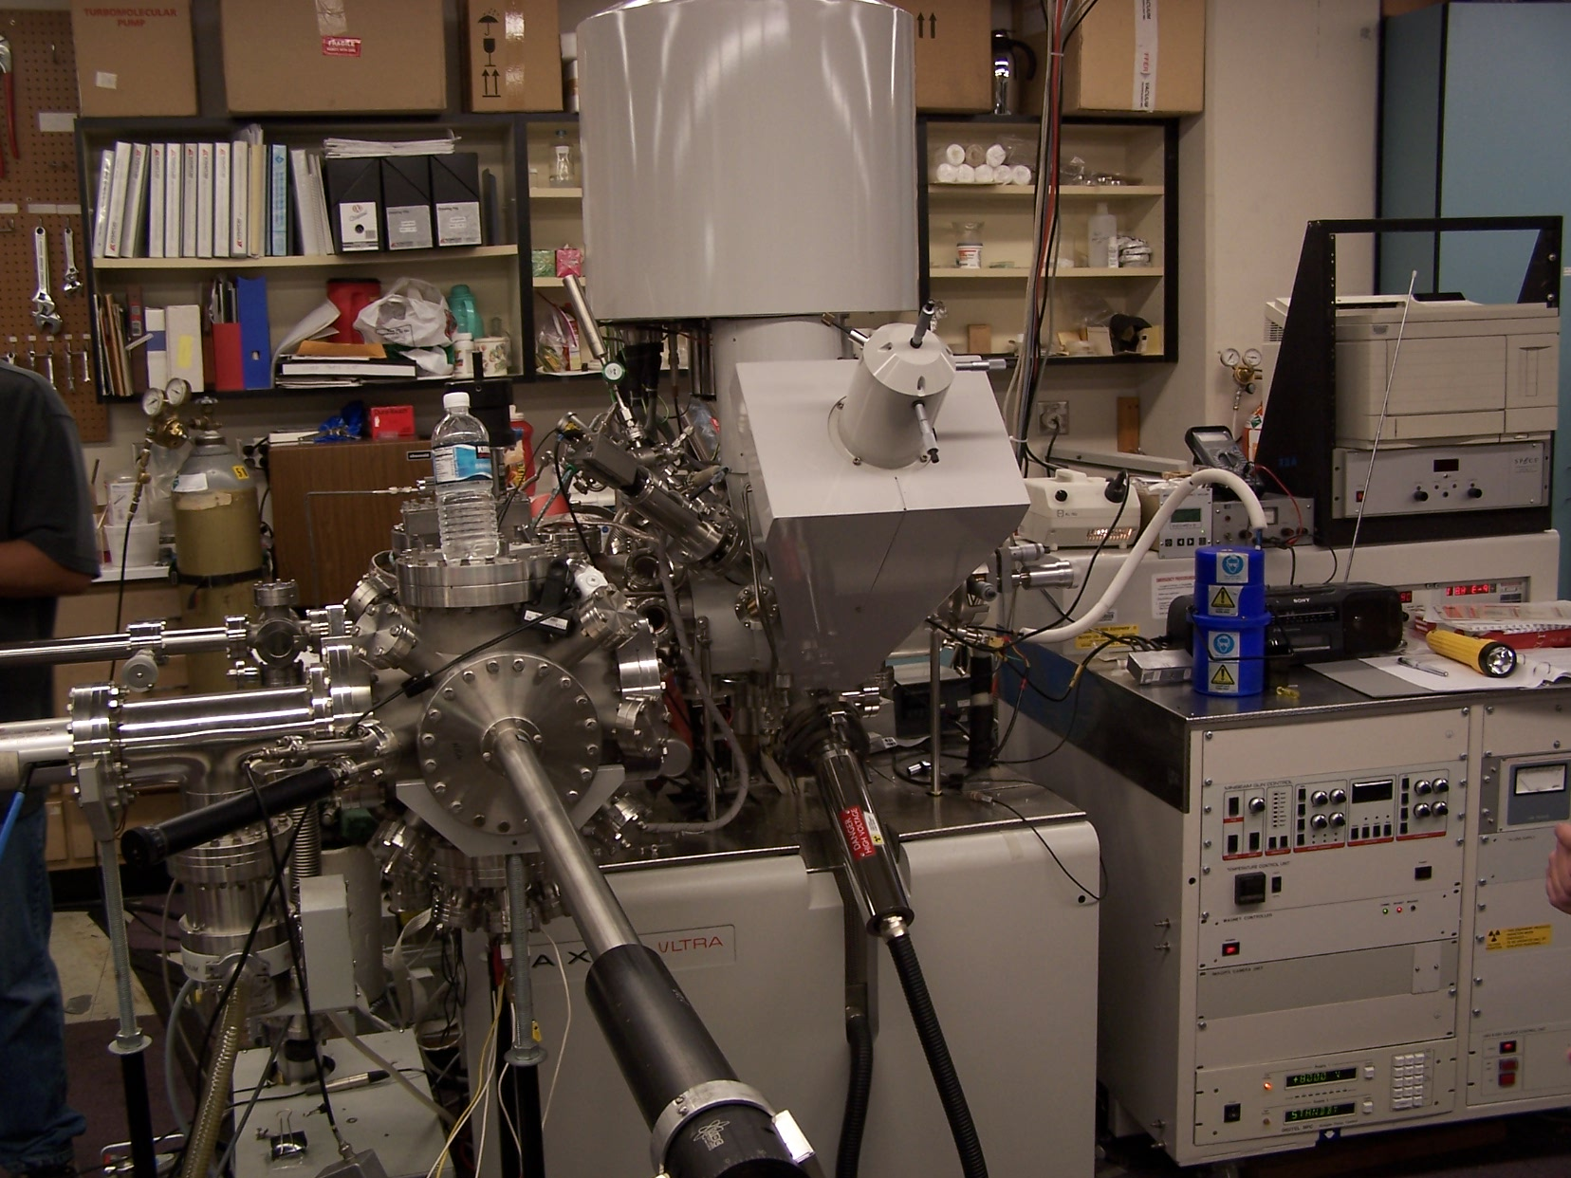
Photoelectron Spectrometer

Slide 10
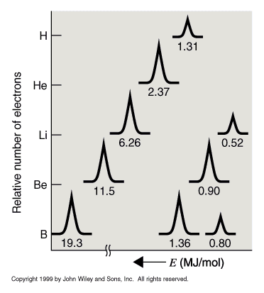
Photoelectron Spectroscopy (PES)
*
H: peak at 1.31 MJ/mole* (1312kJ)
He: peak at 2.37 MJ/mole*
  i.e energy to remove He e⁻ > H e⁻
  note: peak He = 2X peak H
Li: peak at 6.26 MJ/mole 2e⁻
peak at 0.52 MJ/mole* 1e⁻
Be: peak at 11.5 MJ/mole 2e⁻
peak at 0.90 MJ/mole* 2e⁻
B: peak at 19.3 MJ/mole 2e⁻
peak at 1.36 MJ/mole 2e⁻
peak at 0.80 MJ/mole* 1e⁻
BUT! Saw with ionization energies that the three outer electrons for B belong to the same shell (n = 2).
*
*
*
*
* 1st ionization energy

Slide 11
Photoelectron Spectroscopy (PES)
BUT! Saw with ionization energies that the three outer electrons for B belong to the same shell (n = 2).
Must, therefore, refine the model to include SUBSHELLS---members of the same shell, but with different energies.
Subshells given designations:
s, p, d or f, in order of increasing PES energy.
Exponent indicates number of electrons in that subshell.
1s¹
1s²
1s²
2s¹
1s²
2s²
1s²
2s²
2p¹
Same shell, but different subshells.

Slide 12
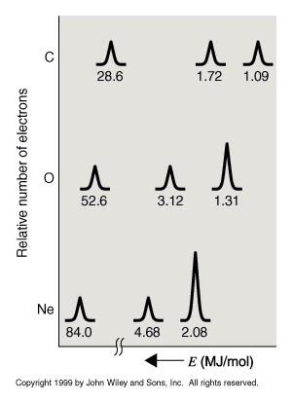
Photoelectron Spectroscopy (PES)
PES Data show only three peaks for B through Ne.
Peak height of third peak increases in size from 1 to 6.
Conclusions:
p subshell can hold up to 6 electrons.
s subshell can hold only up to 2 electrons
p
s

Slide 13
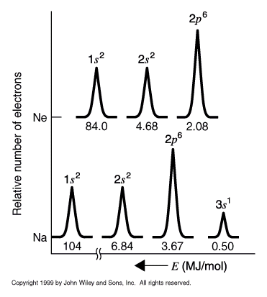
Photoelectron Spectroscopy (PES)
Both Na and Mg show 4 peaks.
  New peak due to 3s subshell
Al through Ar 5 peaks.
  New peak due to 3p subshell (holds up to 6 electrons).
K and Ca show 6 peaks
  New peak due to 4s subshell

Slide 14
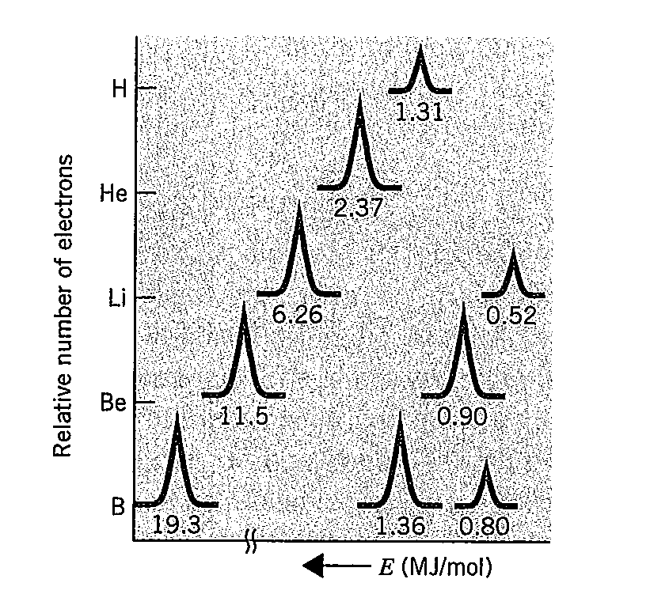

Slide 15
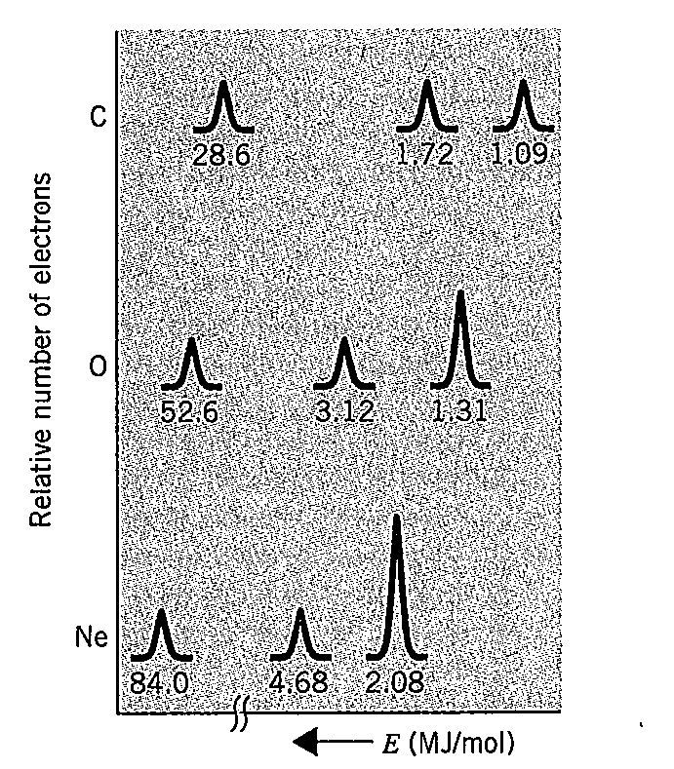

Slide 16
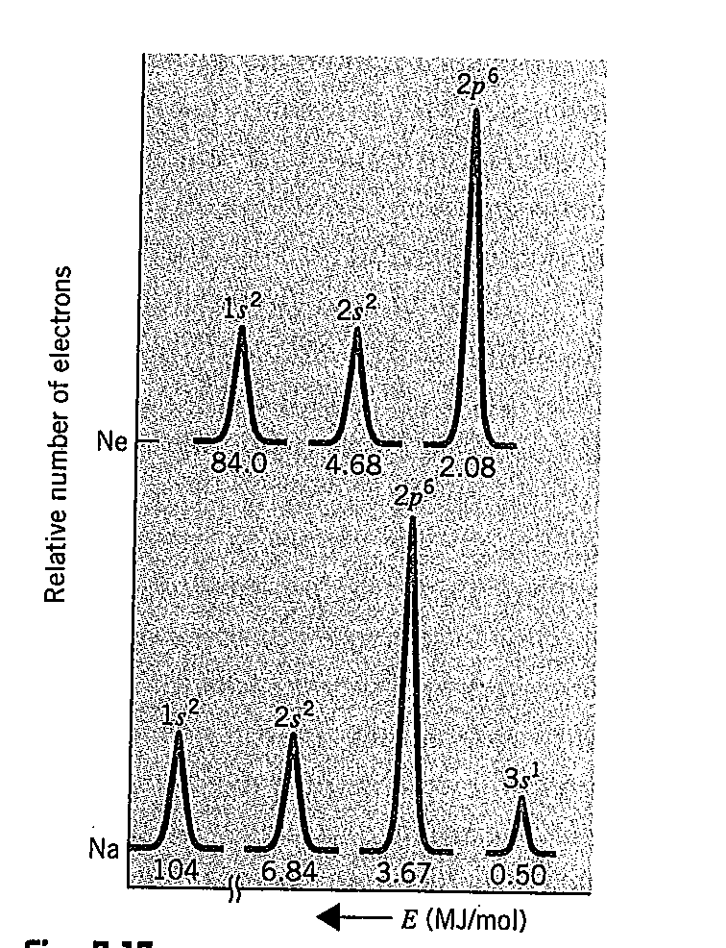

Slide 17
Tutoria

Slide 18
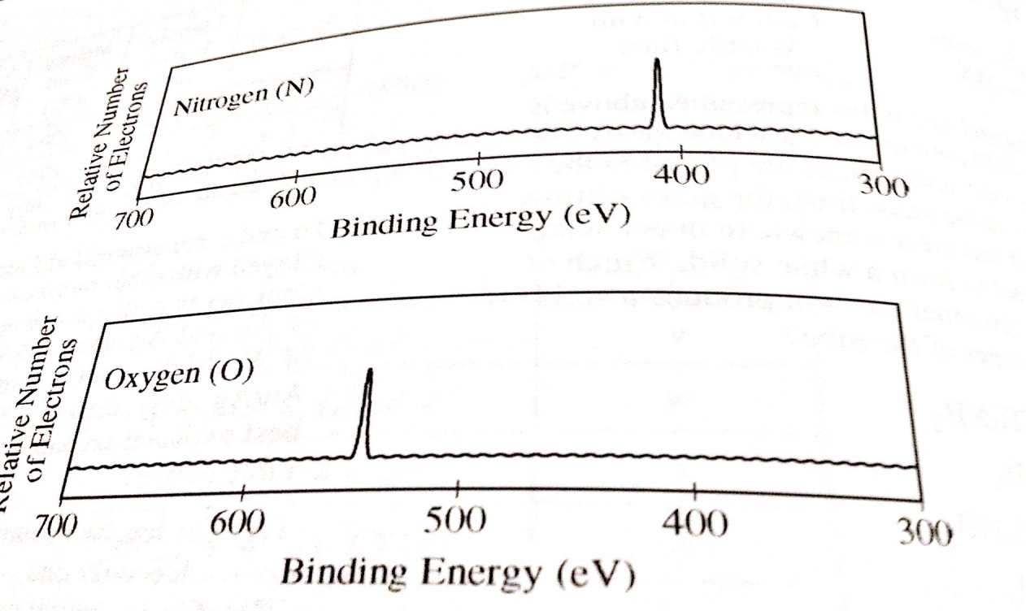
The photoelectron spectra above show the energy required to remove a 1s electron from a nitrogen atom and from an oxygen atom. Which of the following statements best accounts for the peak in the upper spectrum being to the right of the peak in the lower spectrum?
Nitrogen atoms have a half filled p subshell.
B There are more electron-electron repulsions in oxygen atoms than in nitrogen atoms.
C. Electrons in the p subshell of oxygen atoms provide more shielding than electrons in the p subshell of nitrogen atoms
Nitrogen atoms have a smaller nuclear charge than oxygen atoms.

Slide 19
Group Work Questions
Atomic Structure.
  PES 70, 71, 74, 82, 83, 84, 88 (a,b,d) (in Spencer et al.)

